Slide 1

Linear Regression

Slide 2
Recap
Equation of line
Slop
Basic integration xsn
Gradient descent
Differentiations
Maxima
Minima
Basic of ML
Vector
Operations in vector
projections(optional )
Linear algebra
matrix additions
transpose
dot product

Slide 3
Train test split
Train (train , validation) , why validations
Test
Data leakage
Data Preparation and data preprocessing
Duplicate values
Missing values
Outliers
Feature engineering
Data encoding
Ml
Overfitting
Underfitting
Genralized model
Bias- variance trade-off
Variance
Bias

Slide 4
EDA and Preprocessing - AUTOMOBILE CARS
Basic EDA - Info, shape
Handling Missing Values
Handling Outliers
Handling Skewness
Categorical Data Encoding
Data Normalization or Scaling
Feature Engineering

Slide 5
Basic EDA - Info, shape
df.info()
df.describe()

Slide 6
Handling Missing Values
df.isna().sum() # show the null values
df.dtypes
# replace the null with mean or median or anyvalue
df["Fuel_capacity"].fillna(df["Fuel_capacity"].mean())
# df['embark_town'] = df['embark_town'].fillna("Southampton")
df.dropna(inplace=True)
df.isna().sum()
df.duplicated().sum() # check duplicate
# drop duplicate
df.drop_duplicates(inplace=True)

Slide 7
Handling Outliers
Q1 = df['Price_in_thousands'].quantile(0.25)
Q3 = df['Price_in_thousands'].quantile(0.75)
IQR = Q3-Q1
IQR
lower_fence = Q1-1.5*IQR
upper_fence = Q3+1.5*IQR
#dropping the outlier
df_filtered = df[(df.Price_in_thousands >= lower_fence) &
(df.Price_in_thousands <= upper_fence)]
import matplotlib.pyplot as plt
import seaborn as sns
df.columns
#To check outliers >> distplot, boxplot
plt.figure(figsize = (12, 5))
plt.subplot(1, 2, 1)
sns.histplot(df['Price_in_thousands'], kde = True)
plt.title("Dist plot")
plt.subplot(1, 2, 2)
sns.boxplot(data = df, x = 'Price_in_thousands')
plt.title("Box plot")
plt.show()

Slide 8
Handling Skewness
### Understanding the distribution of the column - __year_resale_value
sns.distplot(df['__year_resale_value'], label = 'Skewness: %.2f'%(df['__year_resale_value'].skew()))
plt.legend(loc = 'best')
plt.title('Distribution of the column - __year_resale_value')
import statsmodels.api as sm
from scipy import stats
### Understanding the distribution of the data Box_Cox(__year_resale_value)
year_data = [1 if value == 0 else value for value in modified_dataset['__year_resale_value']]
modified_year, _ = stats.boxcox(year_data)
modified_dataset['__year_resale_value'] = modified_year
sns.distplot(modified_dataset['__year_resale_value'], label = 'Skewness: %.2f'%(modified_dataset['__year_resale_value'].skew()))
plt.legend(loc = 'best')
plt.title('Distribution of the column - __year_resale_value')

Slide 9
Categorical Data Encoding
from sklearn.preprocessing import OneHotEncoder
encoder = OneHotEncoder()
encoder
encoded = encoder.fit_transform(df[['status']]).toarray()
encoder.get_feature_names_out()
#code to seprate numeric and categorical columns and store in DF.
cat_cols = [col for col in df.columns if df[col].dtype == 'object']
num_cols = [col for col in df.columns if df[col].dtype != 'object']
# [final_val for loop conditions ]
for col in cat_cols:
print(f"{col} has {df[col].nunique()} values\n")
### One Hot Encoding the columns - Manufacturer, Vehicle_type of the modified dataset
encoded_dataset = pd.get_dummies(data = modified_dataset, columns = ['Manufacturer', 'Vehicle_type'])
encoded_dataset
from sklearn.preprocessing import LabelEncoder
label_encoder = LabelEncoder()
label_encoder.fit_transform(df[['status']])
#using pandas
pd.get_dummies(df['status'], drop_first=True, dtype = 'int')
from sklearn.preprocessing import OrdinalEncoder
df = pd.DataFrame({"qualification": ["HS", "PG","GR", "HS", "PhD", "HS", "PG"]})
encoder = OrdinalEncoder(categories = [["HS", "GR", "PG", "PhD"]])
encoder.fit_transform(df[['qualification']])

Slide 10
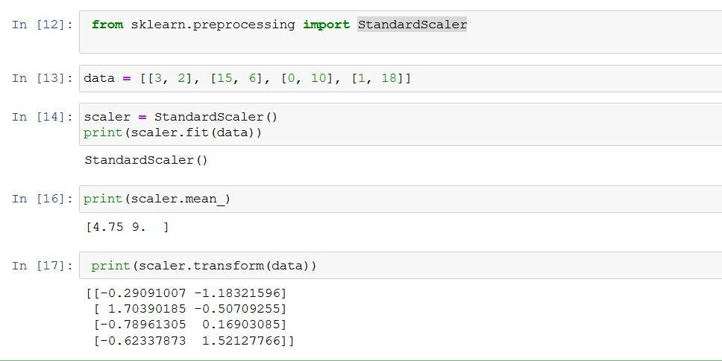
from sklearn import preprocessing
import numpy as np
x_array = np.array([2,3,5,6,7,4,8,7,6])
normalized_arr = preprocessing.normalize([x_array])
print(normalized_arr)
Data Normalization or Scaling
### A function to normalize numerical columns
def normalize_columns(dataframe, column):
data = dataframe[column]
mini = min(data)
maxi = max(data)
new_data = []
for value in data:
new_data.append((value - mini)/(maxi - mini))
dataframe[column] = new_data
numerical_columns = ['Sales_in_thousands', '__year_resale_value', 'Engine_size', 'Horsepower', 'Wheelbase', 'Width',
'Length', 'Curb_weight', 'Fuel_capacity', 'Fuel_efficiency', 'Power_perf_factor', 'Age']
for each_column in numerical_columns:
normalize_columns(modified_dataset, each_column)
scaler = preprocessing.MinMaxScaler()
d = scaler.fit_transform(california_housing.data)
The normalize() function scales vectors individually to a unit norm so that the vector has a length of one.
The default norm for normalize() is L2, also known as the Euclidean norm.
The L2 norm formula is the square root of the sum of the squares of each value.
Although using the normalize() function results in values between 0 and 1,
it’s not the same as simply scaling the values to fall between 0 and 1.

Slide 11
Feature Engineering
Feature selection is the process of reducing the number of input variables when developing a predictive model. It is desirable to reduce the number of input variables to both reduce the computational cost of modeling and, in some cases, to improve the performance of the model.
# 4.6.1 Plotting the correlation matrix for the numerical columns
### Creating a filter_dataset
filter_dataset = encoded_dataset[['Sales_in_thousands', '__year_resale_value', 'Engine_size', 'Horsepower', 'Wheelbase',
'Width', 'Length', 'Curb_weight', 'Fuel_capacity', 'Fuel_efficiency', 'Power_perf_factor',
'Age']]
filter_dataset
### Plotting the correlation between various columns of the filter_dataset
plt.figure(figsize = (10, 10))
heatmap = sns.heatmap(filter_dataset.corr(), vmin = -1, vmax = 1, annot = True)
heatmap.set_title('Correlation Heatmap', fontdict = {'fontsize' : 12}, pad = 12)
# 4.6.2 Removing the columns that cause multicollinearity using VIF

Slide 12
### Detecting the columns that cause multicollinearity using VIF
column_names = list(filter_dataset.columns)
for name in column_names:
if len(column_names) >= 2:
Y = filter_dataset.loc[:, filter_dataset.columns == name]
X = filter_dataset.loc[:, filter_dataset.columns != name]
X = sm.add_constant(X)
linear_model = sm.OLS(Y, X)
results = linear_model.fit()
r_squared = results.rsquared
vif_value = round(1/(1 - r_squared), 2)
print("Column: {} and VIF: {}".format(name, vif_value))
if vif_value > 10:
filter_dataset = filter_dataset.drop([name], axis = 1)
column_names.remove(name)
#clustermap table shows group(cluster ) relationship
plt.figure(figsize = (5, 5))
sns.clustermap(df.corr(), vmin = -1, vmax =1, annot = True)
from statsmodels.stats.outliers_influence import variance_inflation_factor
vif = pd.DataFrame()
vif['Feature'] = df.columns
vif
vif["VIF"] = [variance_inflation_factor(df.values, i) for i in range(len(df.columns))]
Others methods
from sklearn.feature_selection import RFE
rfe = RFE(estimator = LinearRegression(), n_features_to_select=6)
rfe.fit(X, y)
rfe.support_
rfe.ranking_

Slide 13
Data Science
Data Analyst
Excel
Power BI/Tableau
Sql
Python
Data Engineer
Sql
Bigdata concept
Python
Pyspark
Machine Learning engineering
Sql
Basic maths
Python
DL engineering
Sql
Basic maths
Python

Slide 14
Linear Regression
Simple linear regression
One independent and one dependent (X,Y)
Y=mx+c
Error → (yactual – ypredicted)2
And when we need min error from all line
That is called OLS(ordinary Least square ) first basic model in linear regression
And when OLS divide by n (datapoints) then it it average of ols
And called it as cost funtions → MSE
So we optimiz the process of find MSE →using gradient descent
For Least error use 2 approach
1. Close form ax2+bx+c =0 (alfa ,beta)
2. itrative form (gradient solution)
So we observe increase m or decrease m error will change→ so we can say slope increase total error increase and slope decrease also total error increase.
So we want least error so slope =0 for minima in differentiation .
Using convergence algorithms
In machine learning, convergence is when a model's predictions stop improving and the error rate becomes constant. This means that the model has reached a stable state where it can make accurate predictions. Mnew =Mold –eta(or alpha rate /learning rate)D(CF)/Dold

Slide 15
Overfitting
underfitting
train test and validate
validations for improve learning
Bias
Variance
bias-variance trade-off
Genralized model
Linear regression
yactual -y predict

Slide 16
Regression Evaluation Metrics
R –square: =1- SSE/TSS → sse(Yactual – Ypredicted)2
R2 is the % variation in y explained by x.
Adjecent R-square
It penalize the r2 as we added more new feature
We add feature when the model diff in r2 and Adjusted r2 not more than 2-5%.
MSE
Error is quantifiable.
Lower the MSE better the model.
Advantage
disadvantage
RMSE
Root mean square errror
MAE
Less sensitive to outlier
More interpretable
It is same unit

Slide 17
Multiple linear regression
More the 1 independent x variable.
Y not much extract all information from x so more accurate the data need more x’s require.
Equations
Cost funtions

Slide 18
Assumptions of Machine Learning
Assumptions for Linear Regression
Linearity – x & Y should be linear in relationship
Observation are independents
Homoscedasticity → also know as constant variations , the variation of error is constant.
Normality in error →error will be normality distributed.
The feature should not be related → not among relations

Slide 19
Polynomial Regression
Simple polynomial regression
Linear regression
1 independent and 1 dependent variable
polynomial Degree when 0
polynomial Degree when 1
polynomial Degree when 2
polynomial Degree when n
Use when the non linear relationship in variables (also another non linear models use like decision tree).
But as you increase the Degree, you might get an overfitting the model.
Dis advantage
Model will be be overfitting

Slide 20
Multi- coliniarity
Where a feature exhibits a linear relationship withmore then one variable.
It never talk about x→y
It is x1 explain by x2 and x3
What → one feature explain by other feature.
Why → you can not intercept correctly what is the contributions of each indivisual feature w.r.t Y
It is no necessary → no affect on prediction
But it reduce complexity and computition time
Solution find Mulit coliniarirt by (VIF) variance Inflaction factor
Vif = 1/ 1-Ri-square → % variation in y explained by X
Vif 0 to infinite
2nd option RFE(Recursive Feature Elimanations ) when

Slide 21
Regularization
To Add Some thing to regularisation / to penalize
Cost function
→ when m=0 ,yconstant →underfitting
→ when m is infinite → memorize the model and overfitting
So what we do m not 0 or not infinite so we find middle some →so add some error
By
1. Ridge regression = CF+lambda*m-square
2. Lasso Regression
ElasticNet = Ridge + lasso

Slide 22
CrossValidation

